Slide 1
Asymmetric Lepton Flavor Violating Higgs Decays Avital Dery
S. Bressler, AD, A. Efrati, Phys. Rev. D 90 015025 (2014) Editors’ Selection
arXiv:1405.4545

Slide 2
Does the Higgs couple off-diagonally to leptons?
(2012 LHC resonance)

Slide 3
Can the Higgs couple off-diagonally to leptons?
(2012 LHC resonance)
$h→μe$ not likely to be observed.
Strong (model dependent) bound : $BR\left(μ→eγ\right)≤5.7×{10}^{−13}$ [MEG arXiv:1303.0754]
=> $BR\left(h→μe\right)≤O\left({10}^{−9}\right)$

Slide 4
Can the Higgs couple off-diagonally to leptons?
$h→μe$ not likely to be observed.
Strong (model dependent) bound : $BR\left(μ→eγ\right)≤5.7×{10}^{−13}$ [MEG arXiv:1303.0754]
=> $BR\left(h→μe\right)≤O\left({10}^{−9}\right)$
$h→τμ$ or $h→τe$ can exist in observable rates.
$\text{compatible} \text{with} \text{all} \text{current} \text{bounds}\text{. } BR\left(τ→ℓγ\right)≤{O(10}^{−8})$
=> $BR\left(h→τℓ\right)≤O\left(10\%\right)$

Slide 5
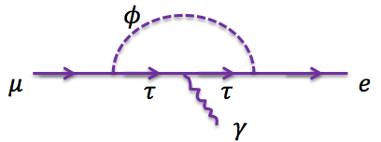
Can the Higgs couple off-diagonally to leptons?
$h→μe$ not likely to be observed.
Strong (model dependent) bound : $BR\left(μ→eγ\right)≤5.7×{10}^{−13}$ [MEG arXiv:1303.0754]
=> $BR\left(h→μe\right)≤O\left({10}^{−9}\right)$
$h→τμ$ or $h→τe$ can exist in observable rates.
$\text{compatible} \text{with} \text{all} \text{current} \text{bounds}\text{. } BR\left(τ→ℓγ\right)≤{O(10}^{−8})$
=> $BR\left(h→τℓ\right)≤O\left(10\%\right)$
$h→τμ$ and $h→τe$cannot coexist in observable rates.
assuming no cancellations ,
$\left|Y_{μτ}Y_{τe}\right|<{1.7×10}^{−7}$
=> $BR\left(h→τμ\right)×BR(h→τe)≤O({10}^{−11})$
$$τ$$
$$τ$$
$$Y_{μτ}$$
$$Y_{τe}$$
[R. Harnik, J. Kopp and J. Zupan, JHEP 1303, 026 (2013) arXiv:1209.1397]

Slide 6
Can the Higgs couple off-diagonally to leptons?
$h→μe$ not likely to be observed.
Strong (model dependent) bound : $BR\left(μ→eγ\right)≤5.7×{10}^{−13}$ [MEG arXiv:1303.0754]
=> $BR\left(h→μe\right)≤O\left({10}^{−9}\right)$
$h→τμ$ or $h→τe$ can exist in observable rates.
$\text{compatible} \text{with} \text{all} \text{current} \text{bounds}\text{. } BR\left(τ→ℓγ\right)≤{O(10}^{−8})$
=> $BR\left(h→τℓ\right)≤O\left(10\%\right)$
$h→τμ$ and $h→τe$cannot coexist in observable rates.
assuming no cancellations ,
$\left|Y_{μτ}Y_{τe}\right|<{1.7×10}^{−7}$
=> $BR\left(h→τμ\right)×BR(h→τe)≤O({10}^{−11})$
For all practical purposes, we can expect to observe
either $h→τμ$, or $h→τe$. (or neither)
$$τ$$
$$τ$$
$$Y_{μτ}$$
$$Y_{τe}$$
[R. Harnik, J. Kopp and J. Zupan, JHEP 1303, 026 (2013) arXiv:1209.1397]

Slide 7
Does the Higgs couple off-diagonally to leptons?
CMS see a $2.5σ$ excess of $h→τμ$ candidate events [CMS-PAS-HIG-14-005]
Best fit point: $BR\left(h→τμ\right)={(0.89}_{−0.37}^{+0.40})\%$
Interpreted as a limit: $BR\left(h→τμ\right)<1.57\%$
order of magnitude better than previous indirect bounds
no direct bound for $BR\left(h→τe\right)$ yet.

Slide 8
Does the Higgs couple off-diagonally to leptons?
CMS see a $2.5σ$ excess of $h→τμ$ candidate events [CMS-PAS-HIG-14-005]
Best fit point: $BR\left(h→τμ\right)={(0.89}_{−0.37}^{+0.40})\%$
Interpreted as a limit: $BR\left(h→τμ\right)<1.57\%$
order of magnitude better than previous indirect bounds
no direct bound for $BR\left(h→τe\right)$ yet.
If $BR\left(h→τℓ\right)≠0$ is established:
clear signal of NP.
challenge for frameworks of flavor.

Slide 9
$h→τℓ$ and Flavor
[AD, A. Efrati, Y. Nir, Y. Soreq, V. Susic, arXiv:1408.1371 ]

Slide 10
$h→τℓ$ and Flavor
[AD, A. Efrati, Y. Nir, Y. Soreq, V. Susic, arXiv:1408.1371 ]
Flavor models relate off-diagonal couplings in a given sector.

Slide 11
$h→τℓ$ and Flavor
[AD, A. Efrati, Y. Nir, Y. Soreq, V. Susic, arXiv:1408.1371 ]
Flavor models relate off-diagonal couplings in a given sector.
Froggatt-Nielsen (FN) mechanism:
Non trivial to generate observable rates for $h→τℓ$. SM or MHDM field content + non-renormalizable terms do not suffice.
Natural models that can saturate the current bounds exist in the context of SUSY, where “holomorphic zeros” allow to avoid FCNCs.

Slide 12
$h→τℓ$ and Flavor
[AD, A. Efrati, Y. Nir, Y. Soreq, V. Susic, arXiv:1408.1371 ]
Flavor models relate off-diagonal couplings in a given sector.
Froggatt-Nielsen (FN) mechanism:
Non trivial to generate observable rates for $h→τℓ$. SM or MHDM field content + non-renormalizable terms do not suffice.
Natural models that can saturate the current bounds exist in the context of SUSY, where “holomorphic zeros” allow to avoid FCNCs.
Minimal Lepton Flavor Violation (MLFV):
The simplest version of MLFV, where there is only one spurion, predicts
zero off-diagonal couplings.
Neutrino related spurions generate off-diagonal couplings. However, in order to approach the current bounds, non-generic parameter relations must exist.

Slide 13
Searching for $h→τ_{lep}ℓ$

Slide 14
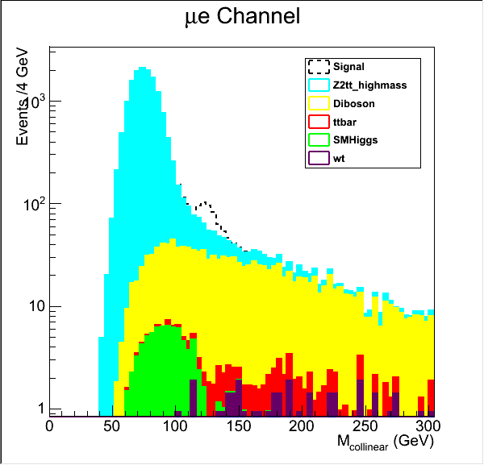
Searching for $h→τ_{lep}ℓ$
Naively - look for a bump in the reconstructed mass distribution.
Estimating the BG accurately is difficult:
The signal lies in a transitional region between differently shaped contributions
Uncertainty in the modelling of the Z tail
$$Z→ττ$$
Diboson

Slide 15
Searching for $h→τ_{lep}ℓ$
We suggest a fully data driven method:
Final state: $e, μ, MET$

Slide 16
Searching for $h→τ_{lep}ℓ$
We suggest a fully data driven method:
Final state: $e, μ, MET$
Divide the data into two mutually exclusive samples:
“$eμ$” “$μe$”
${p_{e}^{T}>p}_{μ}^{T}$ ${p_{μ}^{T}>p}_{e}^{T}$
call the electron $ℓ_{0}$, the muon $ℓ_{1}$ call the muon $ℓ_{0}$, the electron $ℓ_{1}$

Slide 17
Searching for $h→τ_{lep}ℓ$
We suggest a fully data driven method:
Final state: $e, μ, MET$
Divide the data into two mutually exclusive samples:
“$eμ$” “$μe$”
${p_{e}^{T}>p}_{μ}^{T}$ ${p_{μ}^{T}>p}_{e}^{T}$
call the electron $ℓ_{0}$, the muon $ℓ_{1}$ call the muon $ℓ_{0}$, the electron $ℓ_{1}$
SM prediction: $e↔μ$ symmetry.
Gauge interactions are universal.
$p_{}^{T}$-independent differences between electrons and muons (phase space, efficiencies, detector effects) do not induce an asymmetry since the final state has both objects.

Slide 18
Searching for $h→τ_{lep}ℓ$
We suggest a fully data driven method:
Final state: $e, μ, MET$
Divide the data into two mutually exclusive samples:
“$eμ$” “$μe$”
${p_{e}^{T}>p}_{μ}^{T}$ ${p_{μ}^{T}>p}_{e}^{T}$
call the electron $ℓ_{0}$, the muon $ℓ_{1}$ call the muon $ℓ_{0}$, the electron $ℓ_{1}$
SM prediction: $e↔μ$ symmetry.
Gauge interactions are universal.
$p_{}^{T}$-independent differences between electrons and muons (phase space, efficiencies, detector effects) do not induce an asymmetry since the final state has both objects.
$$e$$
$$μ$$
$$=$$
SM
SM
$$μ$$
$$e$$

Slide 19
Searching for $h→τ_{lep}ℓ$
We suggest a fully data driven method:
Final state: $e, μ, MET$
Divide the data into two mutually exclusive samples:
“$eμ$” “$μe$”
${p_{e}^{T}>p}_{μ}^{T}$ ${p_{μ}^{T}>p}_{e}^{T}$
call the electron $ℓ_{0}$, the muon $ℓ_{1}$ call the muon $ℓ_{0}$, the electron $ℓ_{1}$
Signal prediction: $e↔μ$ asymmetry.

Slide 20
Searching for $h→τ_{lep}ℓ$
We suggest a fully data driven method:
Final state: $e, μ, MET$
Divide the data into two mutually exclusive samples:
“$eμ$” “$μe$”
${p_{e}^{T}>p}_{μ}^{T}$ ${p_{μ}^{T}>p}_{e}^{T}$
call the electron $ℓ_{0}$, the muon $ℓ_{1}$ call the muon $ℓ_{0}$, the electron $ℓ_{1}$
Signal prediction: $e↔μ$ asymmetry.
$h→τ_{μ}e$
Will appear in the $eμ$sample:
$$ν_{τ}$$
$$τ$$
$$μ$$
$$h$$
$$\overline{ν_{μ}}$$
$$e$$

Slide 21
Searching for $h→τ_{lep}ℓ$
We suggest a fully data driven method:
Final state: $e, μ, MET$
Divide the data into two mutually exclusive samples:
“$eμ$” “$μe$”
${p_{e}^{T}>p}_{μ}^{T}$ ${p_{μ}^{T}>p}_{e}^{T}$
call the electron $ℓ_{0}$, the muon $ℓ_{1}$ call the muon $ℓ_{0}$, the electron $ℓ_{1}$
Signal prediction: $e↔μ$ asymmetry.
$h→τ_{μ}e$
Will appear in the $eμ$sample:
$h→τ_{e}μ$
Will appear in the $μe$ sample:
$$ν_{τ}$$
$$ν_{τ}$$
$$τ$$
$$μ$$
$$τ$$
$$e$$
$$≠$$
$$h$$
$$\overline{ν_{μ}}$$
$$h$$
$$\overline{ν_{e}}$$
$$e$$
$$μ$$

Slide 22
Asymmetric Lepton Flavor Violating Higgs Decays
SM Background
$μe$ sample
$eμ$ sample

Slide 23
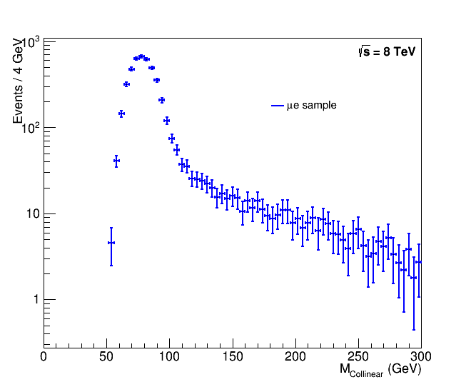
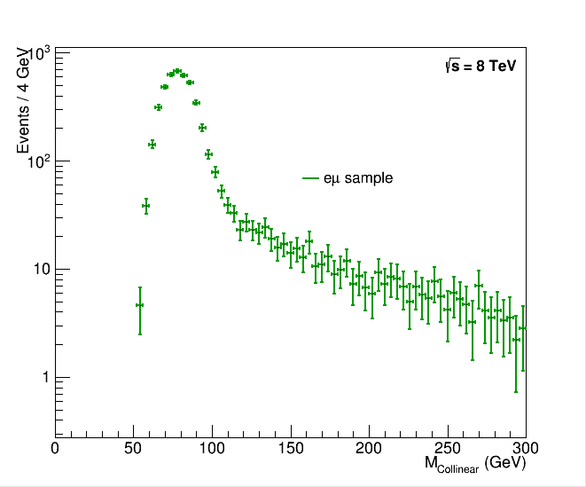
Asymmetric Lepton Flavor Violating Higgs Decays
SM Background
$μe$ sample
$eμ$ sample
simulation
simulation
$$M_{Collinear}=\sqrt{p_{l_{0}}^{T}\left(p_{l_{1}}^{T}+MET\right)\left(coshΔη−cosΔφ\right)}$$

Slide 24
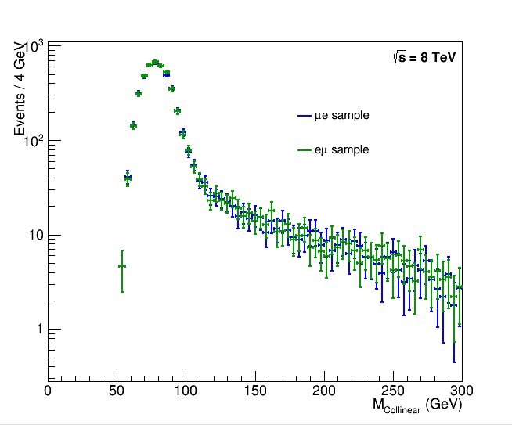
Asymmetric Lepton Flavor Violating Higgs Decays
SM Background
simulation
$$M_{Collinear}=\sqrt{p_{l_{0}}^{T}\left(p_{l_{1}}^{T}+MET\right)\left(coshΔη−cosΔφ\right)}$$

Slide 25
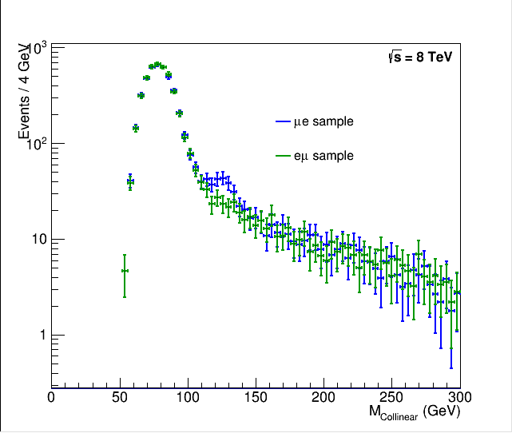
Asymmetric Lepton Flavor Violating Higgs Decays
SM Background + BR($h→τμ)=2\%$
Simulation
Statistical model to capture the amount of asymmetry
Sensitive to the difference of branching ratios
$$BR\left(h→τμ\right)−BR(h→τe)$$
Leading uncertainty stems from statistics – sensitivity will improve with more data

Slide 26
Expected $3σ$ sensitivity
Asymmetric Lepton Flavor Violating Higgs Decays

Slide 27
end

Slide 29
