Slide 1
Workshop on Multi-Higgs Models
_____________________________________________________
Colour-restoration in the Early Universe
with Coloured Higgs
Instituto Superior Técnico | Lisbon
2024-09-03
_____________________________________________________
Marco Finetti
Project ID
PRT/BD/154730/2023 Bolsas de Investigação para Doutoramento FCT-ECIU
Supervisors
António Morais University of Aveiro | Gr@v
Germano Nardini
University of Stavanger
Contributors
Andreas Ekstedt (U. Uppsala)
Mårten Bertenstam (U. Lund)
António Morais (U. Aveiro)
Roman Pasechnik (U. Lund)
Johan Rathsman (U. Lund)
Universidade de Aveiro
theoria poiesis praxis
Notes:
Good morning everyone and thank you for the opportunity to give this lightning talk
on colour-breaking in the early Universe

Slide 2
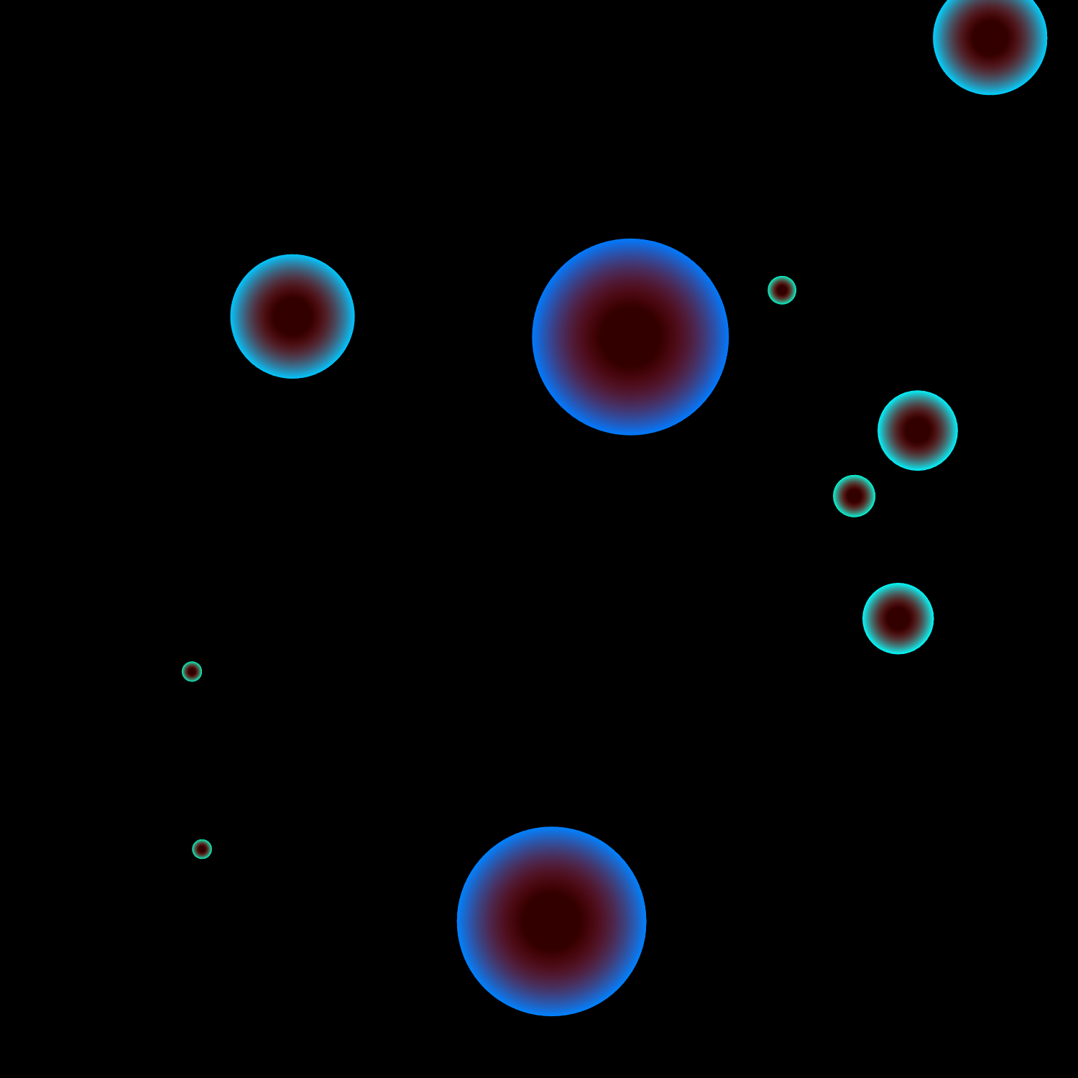
Cosmological Phase Transitions & Single-Field Models
$I$ order phase transitions (FOPTs)
SM
cross-over transition
BSM physics
EW baryogenesis
Breaking of other symmetries?
Is colour-restoration observable
$$V$$
$$T$$
$$\left\langle φ\right\rangle =0$$
$1^{\text{st}}$ order
$2^{\text{nd}}$ order
thermal fluctuation
$$\left\langle φ\right\rangle ≠0$$
cross-over
Background | Paclet | Dimensional reduction | Outlook
roll to true vacuum
75 GeV
$$m_{H}$$
quantum tunnelling
$$φ$$
$$→$$
Notes:
Once derived a thermal EFT we search the parameter space for FOPTs (by means of this hacked version of CosmoTransitions)
Here I will just mention that
we adopt an energy-scale-independent nucleation criterion
we include the vacuum contribution to the energy density of the Universe
and we compute PT parameters, such as
the transition strength$α$
and the inverse duration $β$
at the percolation temperature

Slide 3
Coloured-Higgs A minimal 2-LQ model
$$L$$
Coloured-Higgs model
Higgs-like doublet $H$
coloured-doublet $R$
coloured-singlet $S$
Scalar content $\begin{aligned}V_{LQ}^{\left(0\right)}=&μ_{H}^{2} H^{†}H+μ_{S}^{2} S^{†}S+μ_{R}^{2} R^{†}R \\ &+ λ_{H} {\left(H^{†}H\right)}^{2}+λ_{S} {\left(S^{†}S\right)}^{2}+λ_{R} {\left(R^{†}R\right)}^{2} \\ &+ g_{HS}\left(H^{†}H\right)\left(S^{†}S\right)+g_{HR}\left(H^{†}H\right)\left(R^{†}R\right)+g_{HR}^{′}\left(H^{†}R\right)\left(R^{†}H\right)+g_{RS}\left(R^{†}R\right)\left(S^{†}S\right) \\ &+ a_{1} RSH^{†}+h.c.\end{aligned}$
Features
flavour-consistent: $O\left(100\right)$ observables
radiative generation of $ν$ masses and mixing
generate strong FOPTs
 | $$SU(3)$$ | $$SU(2)$$ | $$U{\left(1\right)}_{Y}$$
$$H$$ | $$1$$ | $$2$$ | $$1/2$$
$$R$$ | $$3$$ | $$2$$ | $$1/6$$
$$S$$ | $$\overline{3}$$ | $$1$$ | $$1/3$$
$$LQ$$
$$Q$$
Background | Model | GW Production | Outcome
Model based on F. Freitas, J. Gonçalves, A. P. Morais, R. Pasechnik, W. Porod (2023, PRD 108.115002)
Notes:
Model
The model we consider features two scalar LQs,
these are hypothetical elementary particles that mix leptons and quarks
a coloured singlet $S$
and a coloured doublet $R$
Scalar content
with a tree-level scalar content shown here
Features
and it combines a few interesting features
It’s consistent with flavour physics, obeying the constraints of order-100 observables
and most importantly
it’s the minimal LQ model capable of radiatively generating neutrino masses
and their mixing structure
and it can produce strong FOPTs
Notice that both these features are enabled by the trilinear coupling $a_{1}$, since
it introduces cubic terms relevant for the FOPTs
and allows for the generation of $ν$ masses at 1-loop

Slide 4
Coloured-Higgs A minimal 2-LQ model
$$L$$
Coloured-Higgs model
Higgs-like doublet $H$
coloured-doublet $R$
coloured-singlet $S$
Scalar content $\begin{aligned}V_{LQ}^{\left(0\right)}=&μ_{H}^{2} H^{†}H+μ_{S}^{2} S^{†}S+μ_{R}^{2} R^{†}R \\ &+ λ_{H} {\left(H^{†}H\right)}^{2}+λ_{S} {\left(S^{†}S\right)}^{2}+λ_{R} {\left(R^{†}R\right)}^{2} \\ &+ g_{HS}\left(H^{†}H\right)\left(S^{†}S\right)+g_{HR}\left(H^{†}H\right)\left(R^{†}R\right)+g_{HR}^{′}\left(H^{†}R\right)\left(R^{†}H\right)+g_{RS}\left(R^{†}R\right)\left(S^{†}S\right) \\ &+ a_{1} RSH^{†}+h.c.\end{aligned}$
Features
flavour-consistent: $O\left(100\right)$ observables
radiative generation of $ν$ masses and mixing
generate strong FOPTs
 | $$SU(3)$$ | $$SU(2)$$ | $$U{\left(1\right)}_{Y}$$
$$H$$ | $$1$$ | $$2$$ | $$1/2$$
$$R$$ | $$3$$ | $$2$$ | $$1/6$$
$$S$$ | $$\overline{3}$$ | $$1$$ | $$1/3$$
$$LQ$$
$$Q$$
Background | Model | GW Production | Outcome
$$H$$
$$\left\langle H\right\rangle$$
$$a_{1}$$
$$S_{1}^{1/3}$$
$$a_{1}$$
$$S_{2}^{1/3}$$
$$R$$
$$S$$
$$ν_{L}$$
$$d_{L}$$
$$d_{R}^{∗}$$
$$ν_{L}$$
Model based on F. Freitas, J. Gonçalves, A. P. Morais, R. Pasechnik, W. Porod (2023, PRD 108.115002)
Notes:
Model
A leptoquark is a hypothetical elementary particle that mixes leptons and quarks
and the model we consider features two scalar LQs,
a coloured singlet $S$
and a coloured doublet $R$
which we allow to acquire a v.e.v.
Scalar content
with a tree-level scalar content shown here
Features
This model is consistent with flavour physics, obeying the constraints of order-100 observables
and most importantly
it’s the minimal LQ model capable of radiatively generating neutrino masses
and their mixing structure
and it can produce strong FOPTs
Notice that both these features are enabled by the trilinear coupling $a_{1}$, since
it introduces cubic terms relevant for the FOPTs
and allows for the generation of $ν$ masses at 1-loop

Slide 5
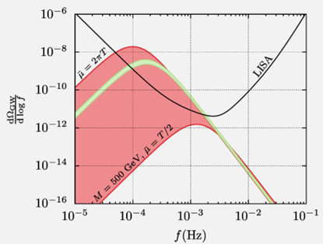
Dimensional Reduction An improved recipe for thermal EFTs
$$V^{\left(1\right)}=\underset{T=0}{\underbrace{V_{0}+V_{CW}^{\left(1\right)}}}+\underset{T≠0}{\underbrace{V_{T}+V_{daisy}}}$$
Leading-order perturbation theory (à la Coleman-Weinberg) Linde problem: non-perturbative massless vector bosons
Dimensional reduction (DR)
time $→$ temperature $⇒$ high-T approach
include systematically higher-order resummations
Narrower theoretical uncertainties
$⇒$ narrower GWB uncertainties
Weakly-coupled EFTs $→$ thermal scale hierarchy
$$t$$
$$τ$$
$$T^{−1}$$
Background | Model | GW Production | Outcome
Credit: P. Schicho
hard
$$∼πT$$
∼𝜋𝑇
semisoft
$$∼{\left(\frac{g}{4π}\right)}^{\frac{1}{2}}πT$$
∼(𝑔/4𝜋)^(1/2) 𝜋𝑇
soft
$$∼\frac{g}{4π}πT$$
∼𝑔/4𝜋 𝜋𝑇
supersoft
$$∼{\left(\frac{g}{4π}\right)}^{\frac{3}{2}}πT$$
∼(𝑔/4𝜋)^(3/2) 𝜋𝑇
ultrasoft
$$∼{\left(\frac{g}{4π}\right)}^{2}πT$$
∼(𝑔/4𝜋)^2 𝜋𝑇
Boltzmann suppression
$$>πT$$
>𝜋𝑇
Figure inspired by eq. (2.1) of O. Gould and T.V.I. Tenkanen (JHEP01(2024)048)
Notes:
Now we want to derive a thermal EFT from the LQ model
yet the standard Coleman-Weinberg approach is affected by the Linde problem, given that massless vector bosons can break perturbativity.
DR
DR enables us to overcome theis problem by including higher-order resummations
Basically in this approach we trade time for temperature
and we match the original 4d theory to an effective 3d theory, that lives exclusively in a high-T regime
In fact, a whole hierarchy of thermal scales emerges in weakly-coupled EFTs
We implemented DR via DRalgo
matching at NLO the 4d theory living at the hard scale to a 3d theory at the ultrasoft scale
and we made use of the model-indep. routine presented by Marten

Slide 6
Outcome From Particle Physics to Cosmology
Particle physics model
thermal EFT
Background | Model | GW Production | Outcome
Notes:
Once derived a thermal EFT we search the parameter space for FOPTs (by means of this hacked version of CosmoTransitions)
Here I will just mention that
we adopt an energy-scale-independent nucleation criterion
we include the vacuum contribution to the energy density of the Universe
and we compute PT parameters, such as
the transition strength$α$
and the inverse duration $β$
at the percolation temperature

Slide 7
Outcome From Particle Physics to Cosmology
Particle physics model
thermal EFT
PT parameters
$T_{p}$, strength $α,$
duration $β^{−1}$,…
Background | Model | GW Production | Outcome
Notes:
Once derived a thermal EFT we search the parameter space for FOPTs (by means of this hacked version of CosmoTransitions)
Here I will just mention that
we adopt an energy-scale-independent nucleation criterion
we include the vacuum contribution to the energy density of the Universe
and we compute PT parameters, such as
the transition strength$α$
and the inverse duration $β$
at the percolation temperature

Slide 8
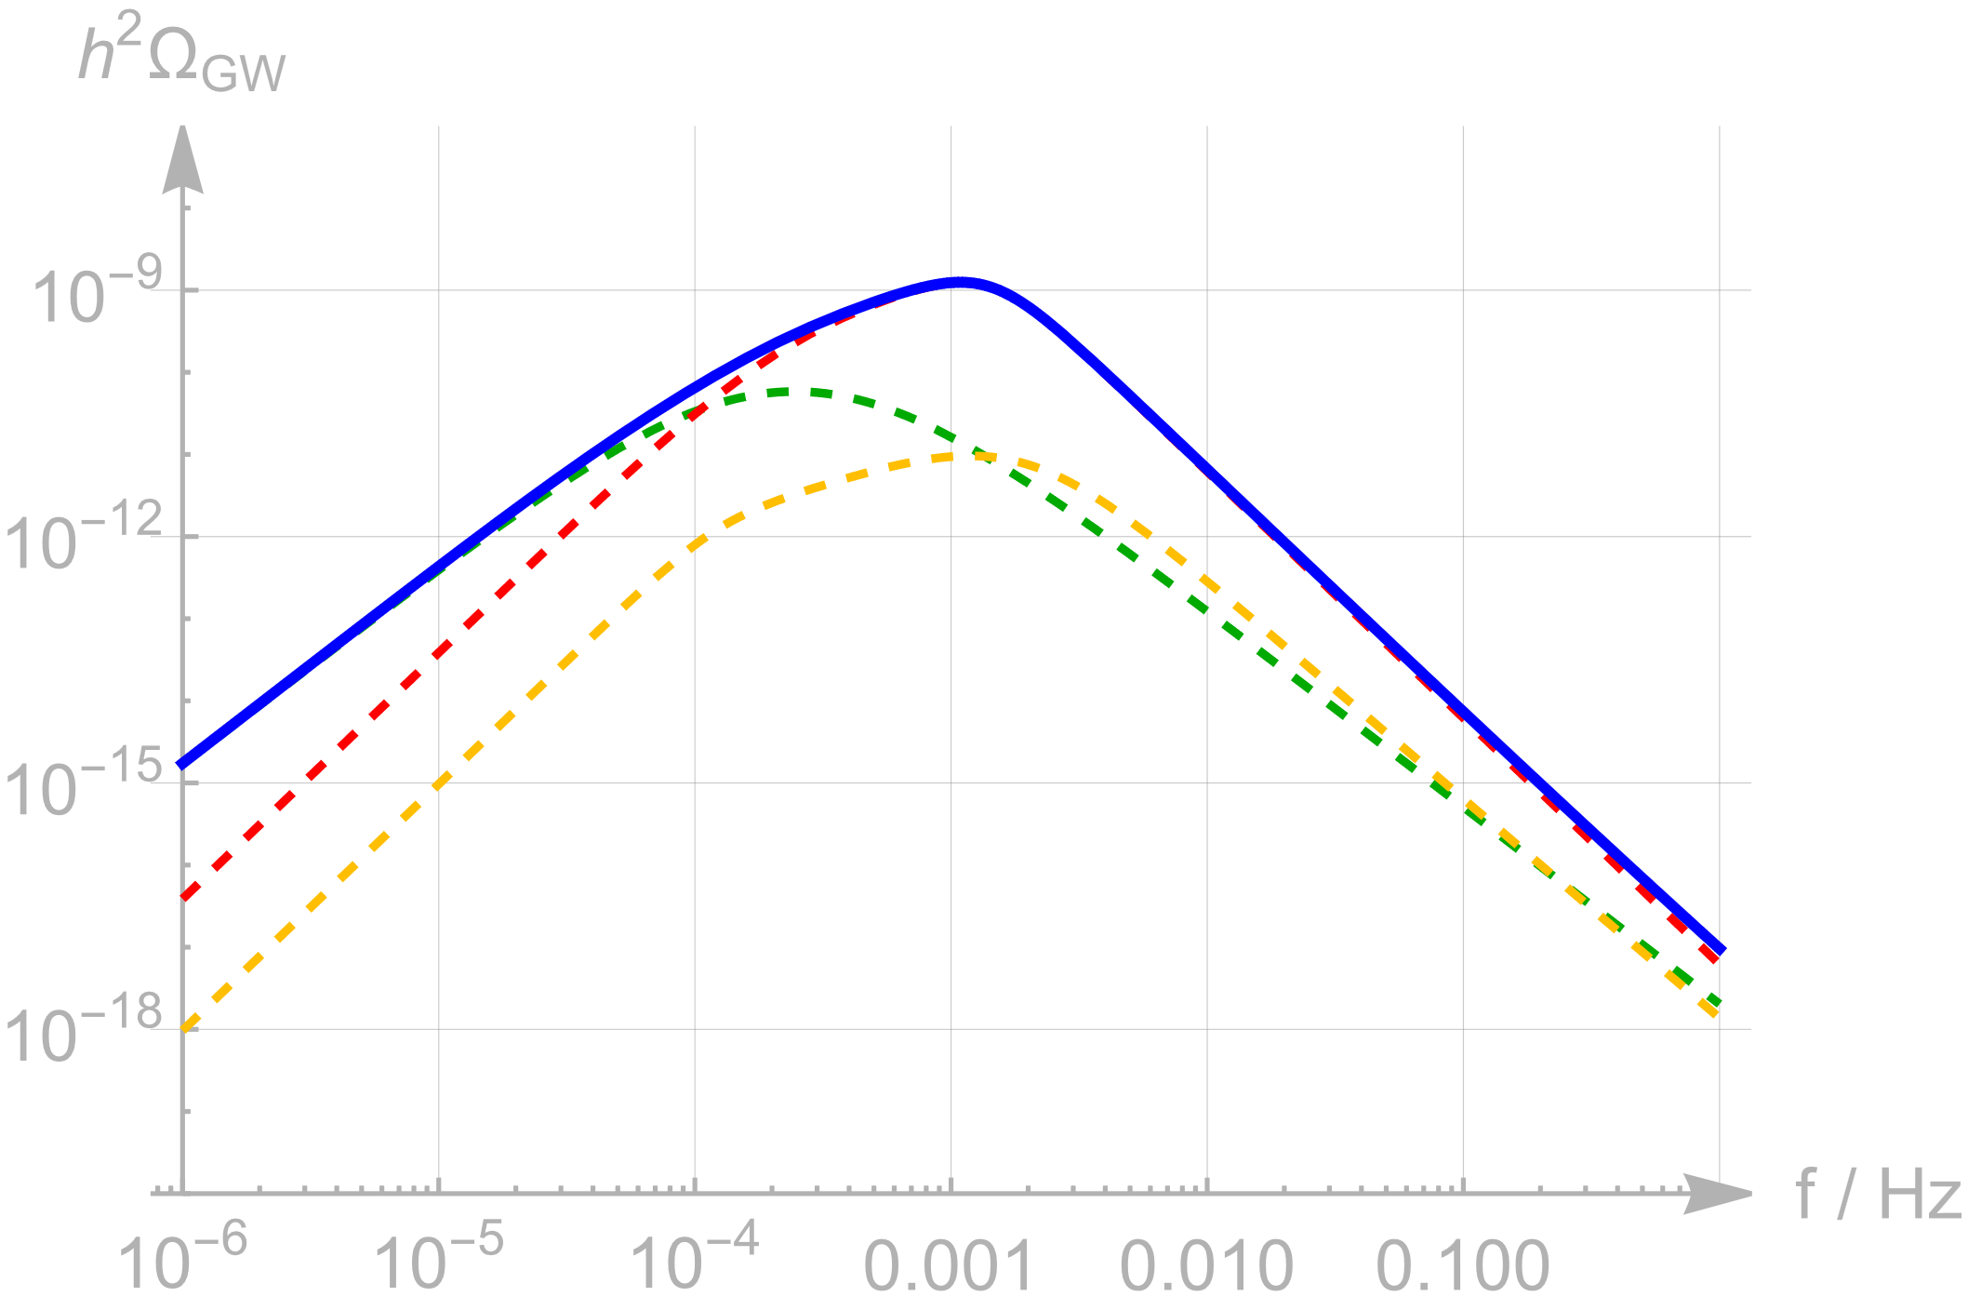
Outcome From Particle Physics to Cosmology
Particle physics model
thermal EFT
collisions
soundwaves
turbulence
combined
PT parameters
$T_{p}$, strength $α,$
duration $β^{−1}$,…
Background | Model | GW Production | Outcome
GW spectrum
$h^{2}Ω_{GW}\left(f_{\text{peak}}\right)$
M. Hindmarsh, S. Huber, K, Rummukainen, D.J. Weir (2015, PRD 92.123009)
Notes:
GWs can be produced by FOPTs via 3 known mechanisms
bubble walls collisions
soundwaves in the plasma of the true vacuum
fluid turbulence
Hydrodynamical simulations
seem to indicate that soundwaves dominate the spectrum
and further provide semi-analytical expressions for this spectrum
So for the sake of this study we focused on the corresponding GW peaks

Slide 9
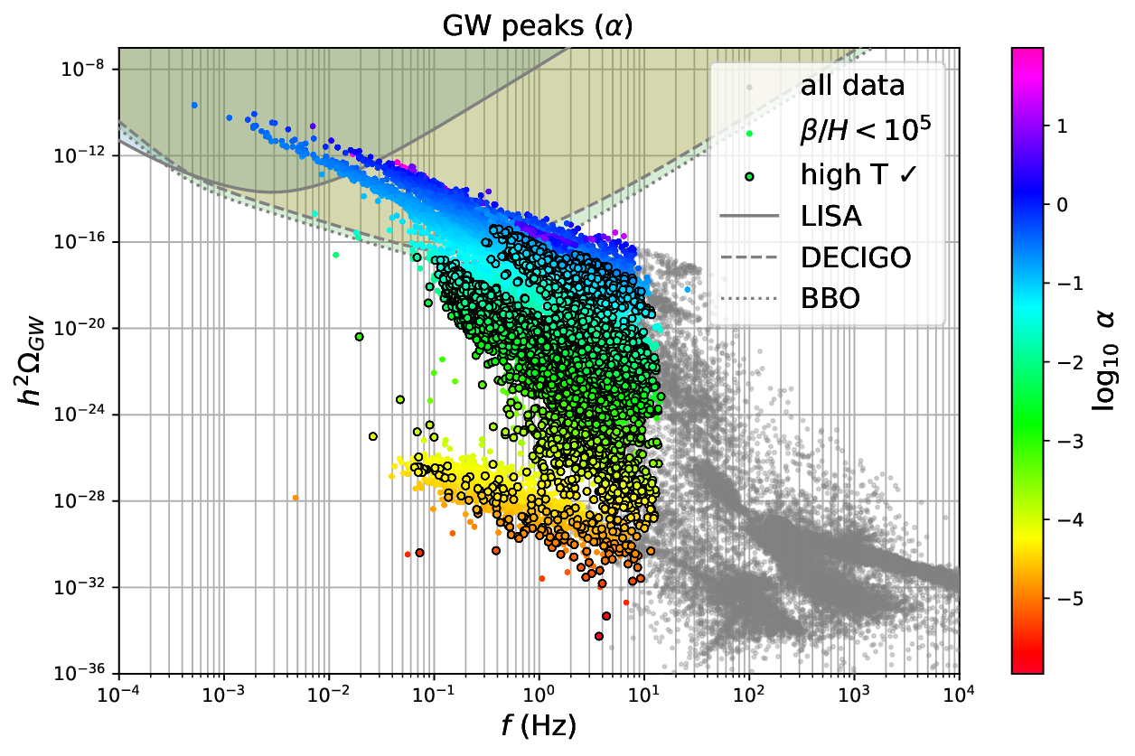
Outcome From Particle Physics to Cosmology
Particle physics model
thermal EFT
collisions
soundwaves
turbulence
combined
PT parameters
$T_{p}$, strength $α,$
duration $β^{−1}$,…
Background | Model | GW Production | Outcome
GW spectrum
$h^{2}Ω_{GW}\left(f_{\text{peak}}\right)$
$\frac{m_{US}}{πT}≲1$
Model parameters scan
masses
couplings
Notes:
Finally, we scan over the parameter space of the theory
giving this distribution of GW peaks,
where the colour indicates the PT strength
We do find PTs detectable at future colliders,
even at LISA
although these are not strictly consistent with the high-T expansion
as indicated by the circled dots
This is not a clear cutoff, and the value of this ratio is still of order 1

Slide 10
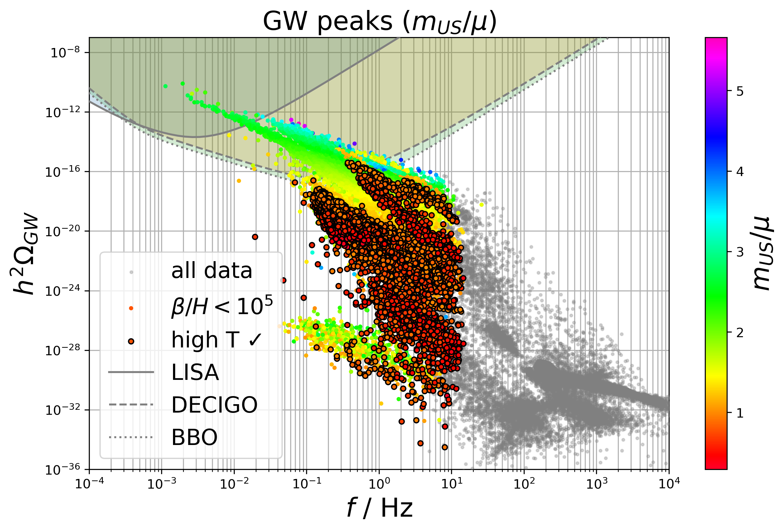
Outcome From Particle Physics to Cosmology
Particle physics model
thermal EFT
collisions
soundwaves
turbulence
combined
PT parameters
$T_{p}$, strength $α,$
duration $β^{−1}$,…
Background | Model | GW Production | Outcome
GW spectrum
$h^{2}Ω_{GW}\left(f_{\text{peak}}\right)$
$\frac{m_{US}}{πT}≲1$
Model parameters scan
masses
couplings
Notes:
Finally, we scan over the parameter space of the theory
giving this distribution of GW peaks,
where the colour indicates the PT strength
We do find PTs detectable at future colliders,
even at LISA
although these are not strictly consistent with the high-T expansion
as indicated by the circled dots
This is not a clear cutoff, and the value of this ratio is still of order 1

Slide 11
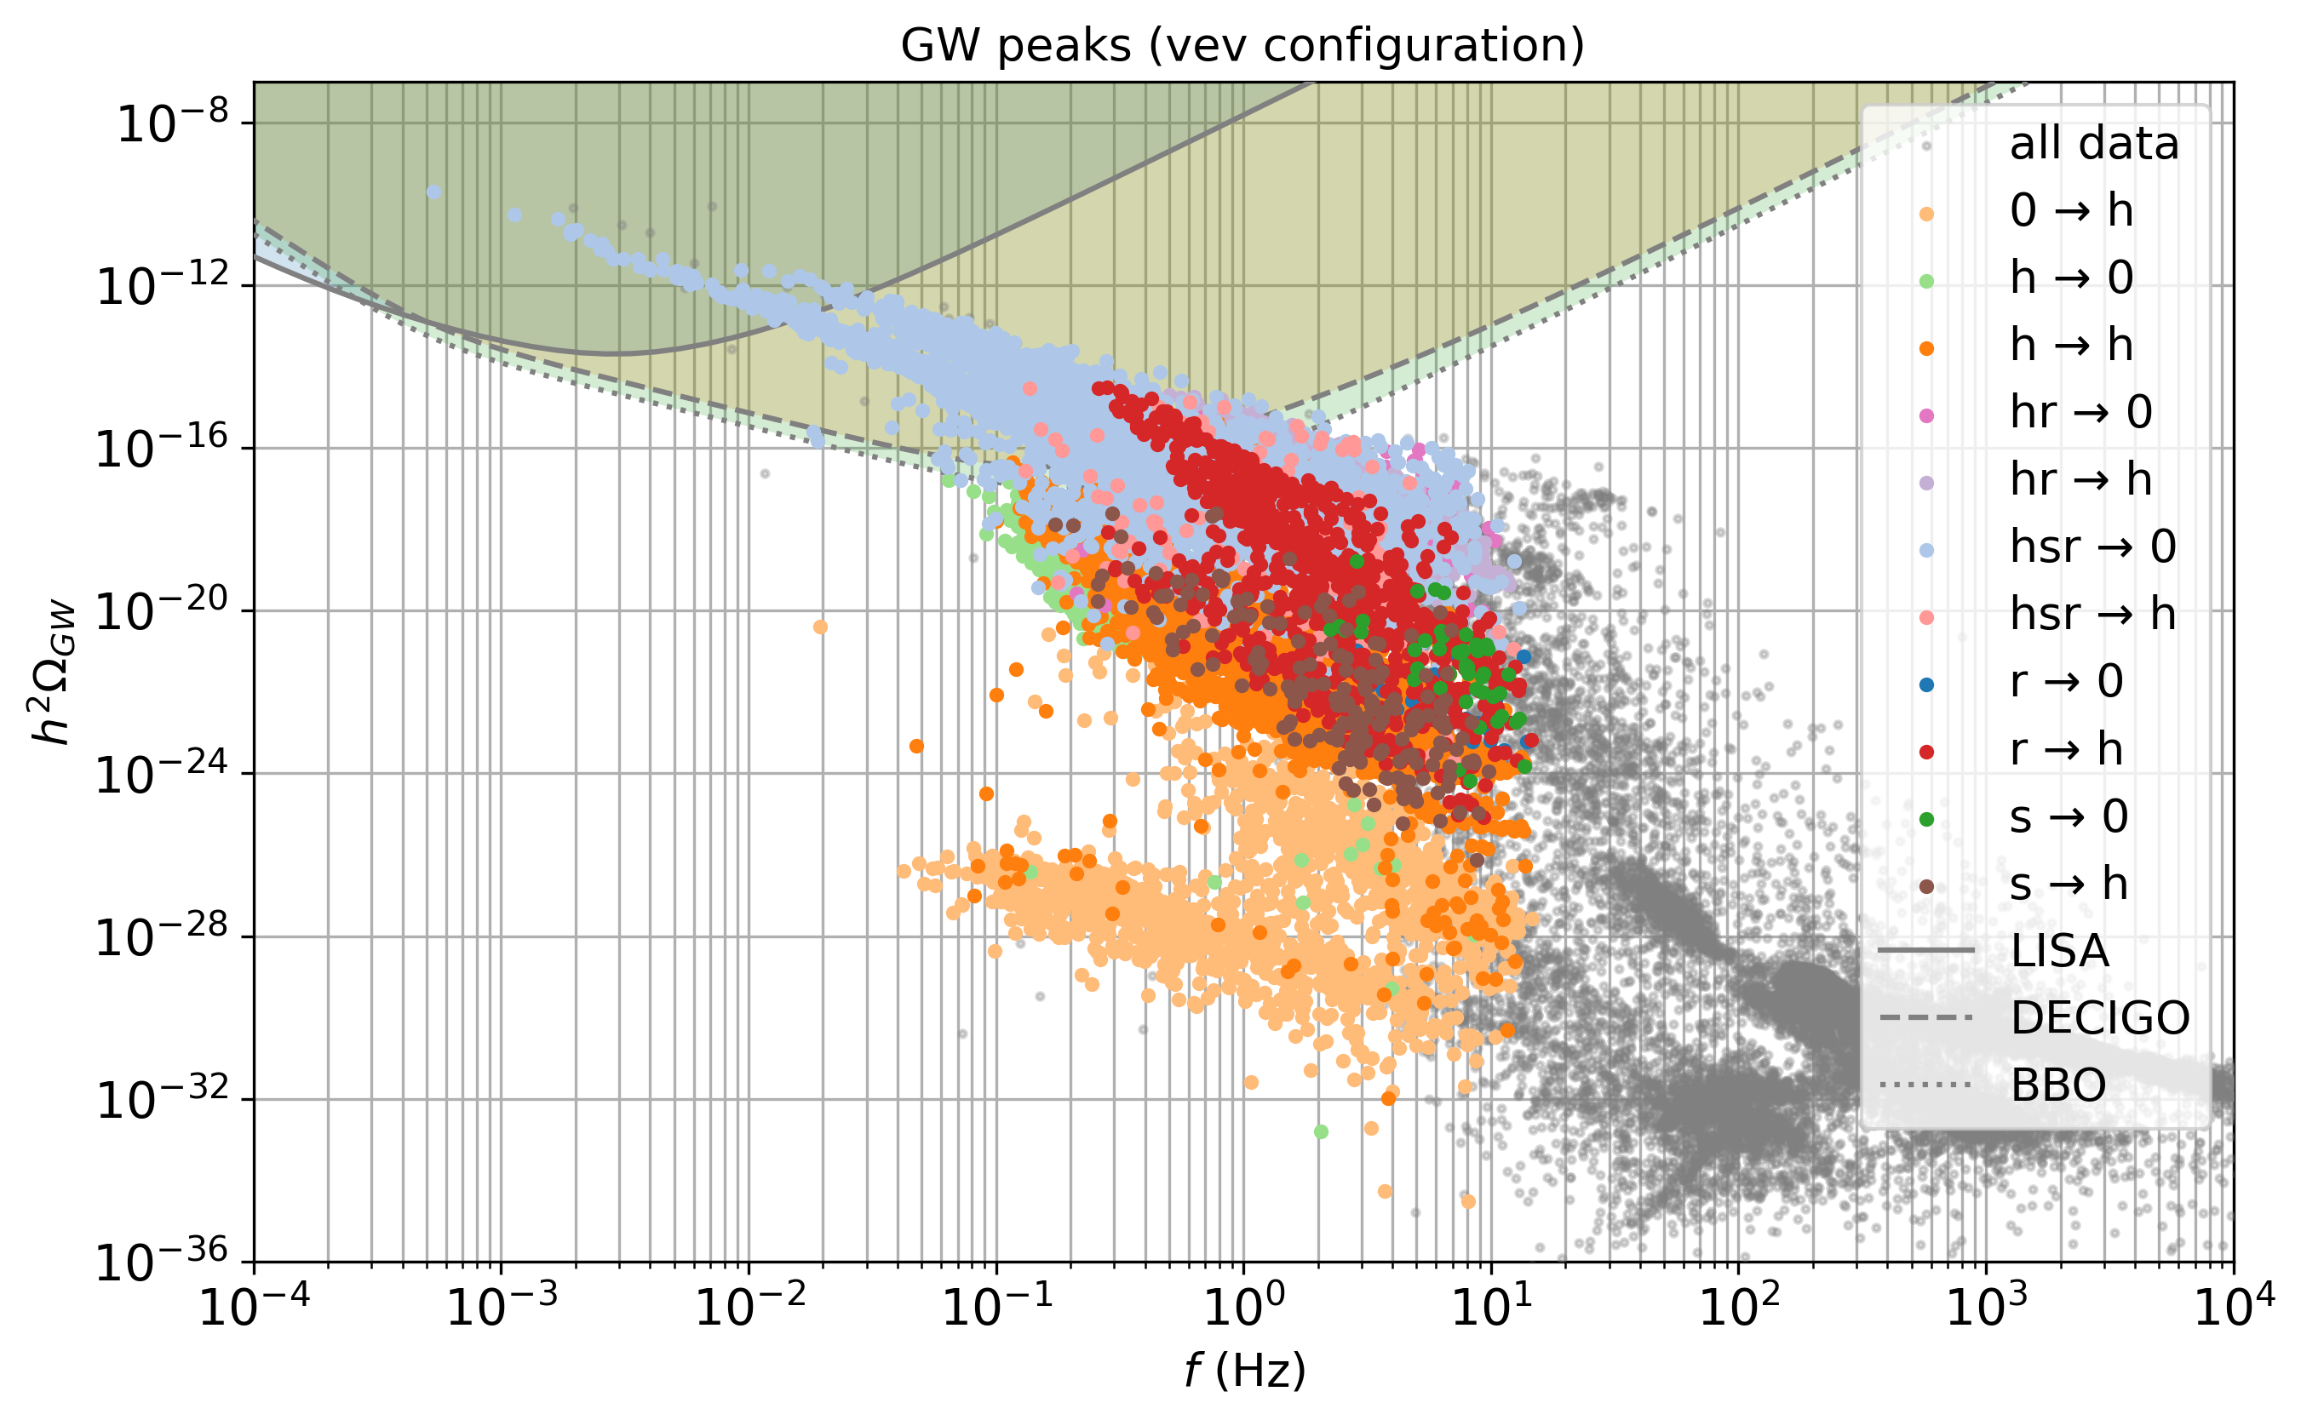
Outcome From Particle Physics to Cosmology
Particle physics model
thermal EFT
PT parameters
$T_{p}$, strength $α,$
duration $β^{−1}$,…
Background | Model | GW Production | Outcome
GW spectrum
$h^{2}Ω_{GW}\left(f_{\text{peak}}\right)$
Colour breaking
and restoration!
Model parameters scan
masses
couplings,…

Slide 12
Outcome & Future Endeavours
Model
flavour-consistent LQ model generating $ν$ masses
featuring colour-breaking at high-$T$
and colour-restoration at lower $T$
Detectability
at future detectors (DECIGO, BBO, ..)
correlation GW$↔$collider observables
Further developments
DRalgo: EFT at NNLO
bubble wall velocity $v_{w}$ (in L.T.E.)
Decay rate prefactor $Γ=A e^{−S_{3}/T}$
Background | Model | GW Production | Outcome
$v_{w}$?
$${\left\langle φ\right\rangle }_{TRUE}$$
$${\left\langle φ\right\rangle }_{FALSE}$$
Notes:
I leave you with the conclusions and further developments

Slide 13
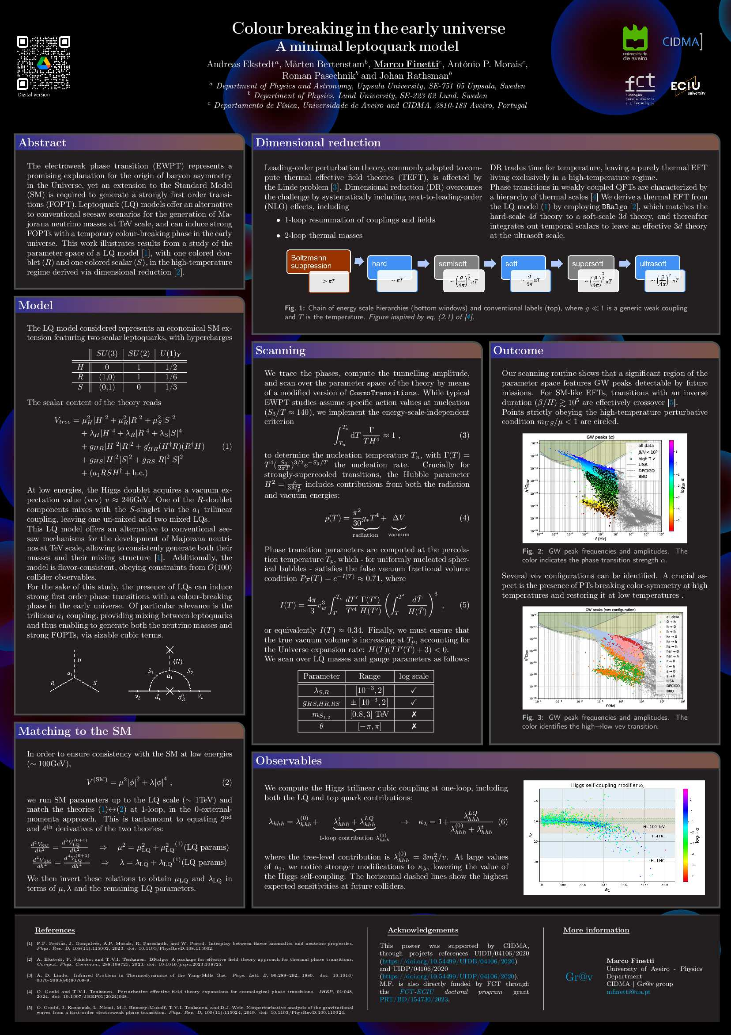
Thanks for listening!
Background | Model | GW Production | Outcome
Notes:
I leave you with the conclusions and further developments

Slide 14
Additional slides

Slide 15
Outcome From Particle Physics to Cosmology
Nucleation criterion: $\int_{T_{n}}^{T_{c}}{dT\frac{Γ\left(T\right)}{T H^{4}\left(T\right)}}≈1$
$Γ\left(T\right)={T^{4}\left(\frac{S_{3}}{2πT}\right)}^{3/2}e^{−S_{3}/T}$
Particle physics model
thermal EFT
energy density: 𝜌𝑇=𝜋230𝑔∗𝑇4radiation+𝜋230Δ𝑉vacuum
$→H^{2}=\frac{ρ}{3M_{P}^{2}}$
PT parameters
$T_{p}$, strength $α,$
duration $β^{−1}$,…
Background | Model | GW Production | Outcome
percolation criterion: $I\left(T_{p}\right)≈0.34$
$$I\left(T\right)=\frac{4π}{3}v_{w}^{3}\int_{T}^{T_{p}}{\frac{dT^{′}}{T^{′4}}\frac{Γ\left(T^{′}\right)}{H^{4}\left(T^{′}\right)}{\left(\int_{T}^{T^{′}}{\frac{d\tilde{T}}{H\left(\tilde{T}\right)}}\right)}^{3}}$$
percolation condition: $𝒱_{FV}^{′}\left(t_{p}\right)<0$
$$H\left(T\right)\left(TI^{′}\left(T\right)+3\right){\left.​\right|}_{T_{p}}<0$$
strength $α=\frac{1}{ρ}Δ\left(V−\frac{T}{4}∂_{T}V\right)$
duration𝑎−1 $\frac{β}{H}=T\frac{d}{dT}\left(\frac{S_{3}}{T}\right)$
Notes:
Once derived a thermal EFT we search the parameter space for FOPTs (by means of this hacked version of CosmoTransitions)
Here I will just mention that
we adopt an energy-scale-independent nucleation criterion
we include the vacuum contribution to the energy density of the Universe
and we compute PT parameters, such as
the transition strength$α$
and the inverse duration $β$
at the percolation temperature

Slide 16
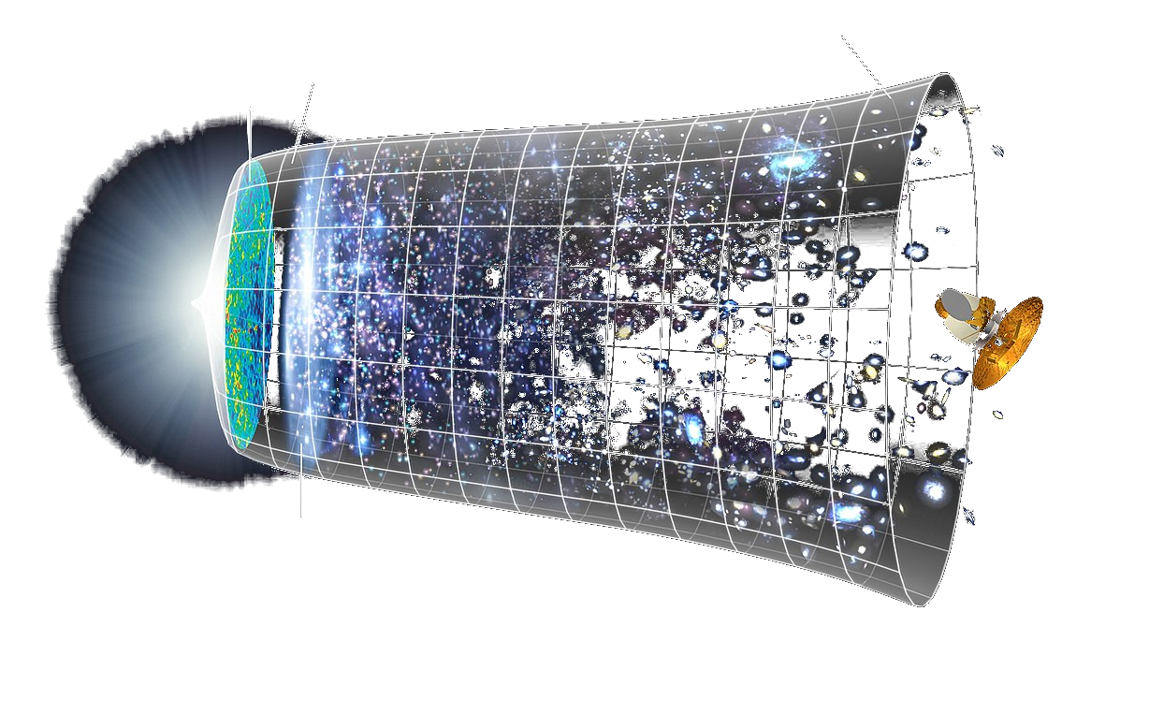
Gravitational Wave Sources
DE expansion
CMB
dark ages
SGWB
CBC
age of the universe
years
hours
sec
wave period
1st stars
Background | Model | GW Production | Outcome
-16
-14
-12
-10
-8
-6
-4
-2
0
2
$\log{f}$ (Hz)
$$T$$
$$\left\langle φ\right\rangle =0$$
$1^{\text{st}}$ order
Main Sources | Frequency (Hz)
Inflation & preheating | ??
Cosmic defects | ${10}^{−12}−{10}^{−10}$ (strings)
Supermassive BH binaries | $${10}^{−10}−{10}^{−7}$$
Phase transitions | $\sim {10}^{−5}−{10}^{−2}$ (EW)
Primordial BHs | $$\sim {10}^{1}−{10}^{2}$$
Main Sources | Frequency (Hz)
Inflation & preheating | ??
Cosmic defects | ${10}^{−12}−{10}^{−10}$ (strings)
Supermassive BH binaries | $${10}^{−10}−{10}^{−7}$$
Phase transitions | $\sim {10}^{−5}−{10}^{−3}$ (EW)
Primordial BHs | $$\sim {10}^{1}−{10}^{2}$$
$2^{\text{nd}}$ order
$$\left\langle φ\right\rangle ≠0$$
cross-over
75 GeV
$$m_{H}$$
Is colour-restoration observable
?
Notes:
GWs
As we’ve seen, besides the observed GWs
originating from compact binaries
we expect a stochastic background of GWs
from the early Universe
for which PTA recently brough forward some experimental evidence
Various sources have been proposed
and I will focus on EW-scale, FOPTs
which target the frequency band of LISA
LISA Redbook: Gravitational waves (GWs) in the Frequency Band of 0.1 mHz – 1.0 Hz with a GW Strain Spectral Density: ${10}^{−21}–{10}^{−23}$
It is well known that the SM alone cannot produce a FOPT
so new physics is required
this opens the possibility to search for the break of other symmetries, besides the EW one
In this study we address the question of whether colour breaking, and color restoration, are observable at future detectors

Slide 17
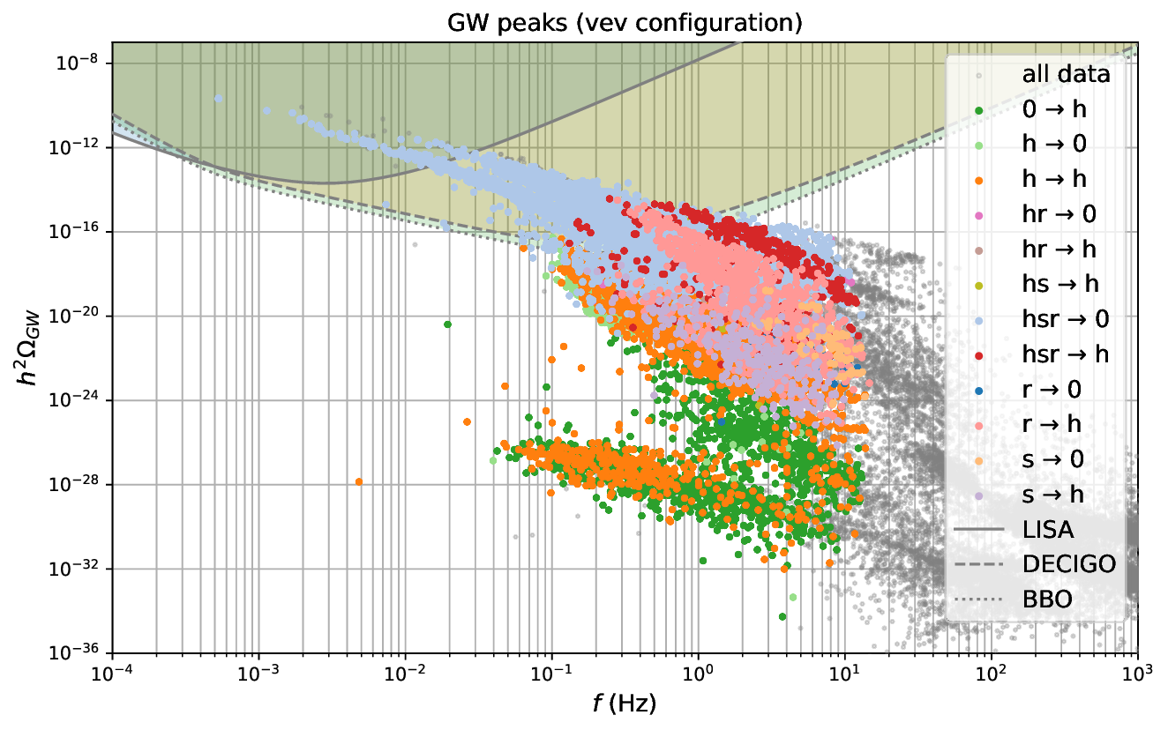
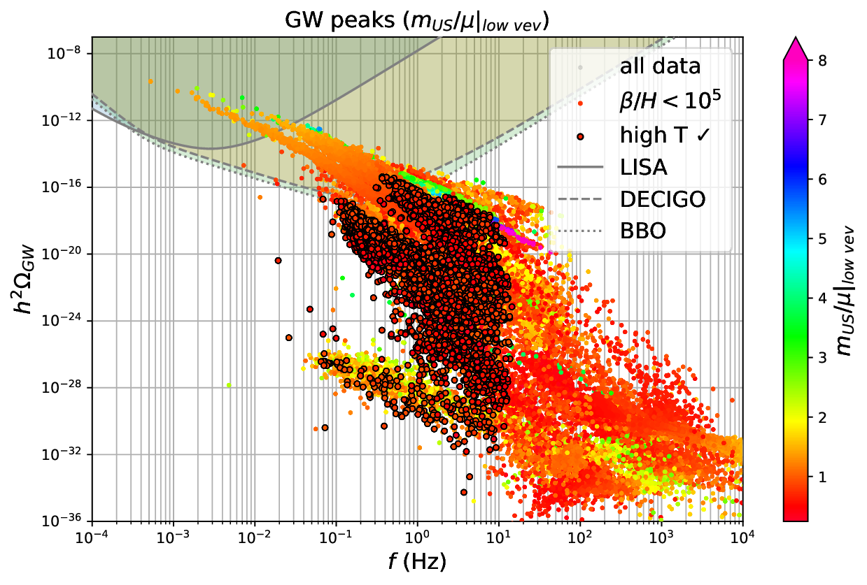
Outcome From Particle Physics to Cosmology
Particle physics model
thermal EFT
PT parameters
$T_{p}$, strength $α,$
duration $β^{−1}$,…
Background | GW production | Outcome
GW spectrum
$h^{2}Ω_{GW}\left(f_{\text{peak}}\right)$
Model parameters scan
masses
couplings
Notes:
Once derived a thermal EFT (via DR in this particular case) the pipeline to obtain GW signals provides for
the computation of phase transition parameters, namely
its strength, duration and bubble wall dynamics
What about GWs?
These are produced by the collision of the bubble walls we saw previously
and the soundwaves in the plasma they contain
It turns out we can derive, with a good approximation, GW parameters
from these simple PT parameters (there are semi-analytical expressions)
from these parameters, we derive the GW spectrum, amplitude vs $\log{f}$
We then iterate this process over and over
varying the parameters of the original particle physics model
and we only look at the peaks of these spectra
Here, color indicates the strength of the PTs
We find that indeed, there are GWs strong enough
to be detectable by LISA

Slide 18
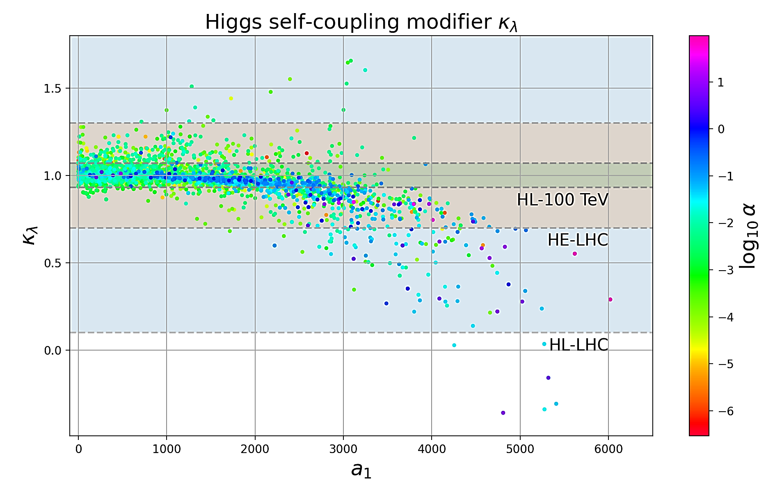
Outcome From Particle Physics to Cosmology
Particle physics model
thermal EFT
PT parameters
$T_{p}$, strength $α,$
duration $β^{−1}$,…
Background | Model | GW Production | Outcome
GW spectrum
(GeV)
$h^{2}Ω_{GW}\left(f_{\text{peak}}\right)$
$$H$$
$$κ_{λ}≡\frac{λ_{hhh}^{BSM}}{λ_{hhh}^{SM}}=1+\frac{λ_{hhh}^{LQ}}{λ_{hhh}^{\left(0\right)}+λ_{hhh}^{t}}$$
Model parameters scan
$$H$$
$$H$$
masses
couplings
Notes:
We may also draw a connection with collider observables
looking at the Higgs cubic self coupling $λ$
and it’s modifier $κ_{λ}$

Slide 19
EW Baryogenesis The matter-antimatter problem
Fundamental problem: baryon asymmetry
Sakharov conditions (1967) | SM | LQ Model
B-number violation | ✓ $→$ non-perturbatively | ✓ $→$ LQs acquire vev
C & P violation | ✓ $→$ weakly | ✓ $→$ potential
Departure from $T$-equilibrium | ✗ $→$ cross-over | ✓ $→$ strong FOPTs
Background | Model | GW Production | Outcome
$$T$$
CP
$$χ_{L}+χ_{R}$$
$$\left\langle φ\right\rangle =0$$
$1^{\text{st}}$ order
$$χ_{L}$$
BSM physics
required!
B+L
$2^{\text{nd}}$ order
$$B$$
$$v_{w}$$
$$\left\langle φ\right\rangle ≠0$$
cross-over
$$\left\langle φ\right\rangle ≠0$$
$$\left\langle φ\right\rangle =0$$
75 GeV
$$m_{H}$$
Notes:
B. asym. remains a fundamental problem in particle physics and cosmology
Sakharov conditions
EW Baryogenesis EWBG is a framework (hypothetical process that took place in the early universe) that allows to produce b. asym. while obeying Sakharov cond.s
SM The SM does satisfy the first 2 conditions
the first condition, although non-perturbatively
the second condition, although weakly
although too weakly to account necessary baryon asymmetry in the early Universe.
And anyways, the EWPT is notoriously cross-over in the SM,
given measure mass of the Higgs boson.
New physics is required
This framework allows us not only to probe the breaking of the EW sym.,
but also, to potentially detect the breaking of other symmetries, such as the colour-symmetry.
Alternative theories
GUT-scale baryogenesis
but $B+L$ violating processes (sphalerons)
Local b. asym. Matter/antim. separated into widely distant regions of the universe.
But this would give a specific gamma ray luminosity at the boundaries. NOT detected.
Mirror anti-universe A universe-antiuniverse pair was created at big bang, proposing that T-fluctuations in CMB are due to QM nature of BB singularity. It can also account for DM, producing many (superheavy) sterile neutrinos.
But it is not clear if it explains homogeneity of universe on large scale (inflation)

Slide 20
TBounce A Mathematica tool for GW computations

Slide 21
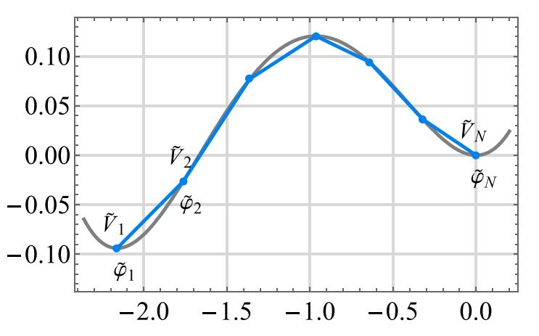
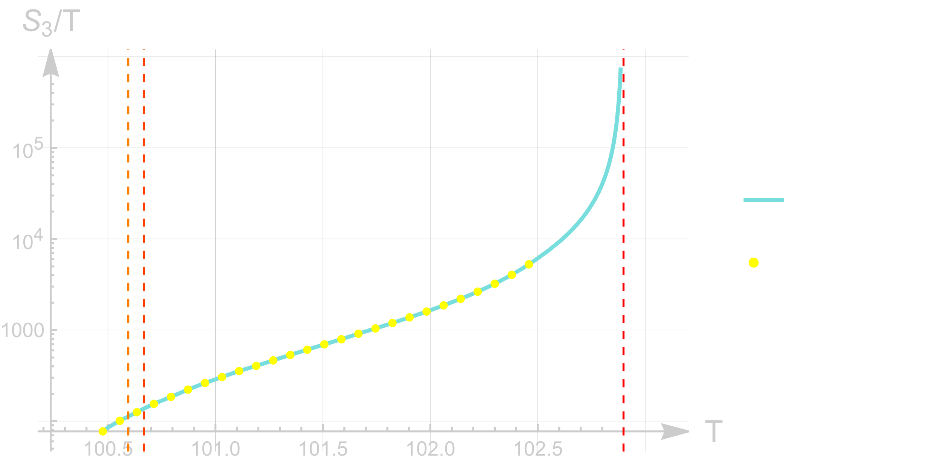
Paclet FindBounce + action fit
Pipeline requires to determine temperatures of
nucleation $\int_{T_{n}}^{T_{c}}{dT\frac{Γ\left(T\right)}{T H^{4}\left(T\right)}}∼1$
percolation $I\left(Γ,T_{p}\right)≈0.34$
$\frac{S_{3}}{T}\left(T\right)$ numerical estimation: FindBounce
implements polygonal bounces
$4d \left(S_{4}\right)$ or $3d \left(S_{3}\right)$
thin-wall regime
efficient: $t∼O\left(\# fields\right), O(\# segments)$
Method
${\hat{T}}_{n}$ estimate via $Γ/H^{4}∼1$
$S_{3}/T$ fit/interpolation about $\left(∼{\hat{T}}_{n},T_{c}\right)$
$T_{n},T_{p}$ via above integrals
$\left.\begin{matrix} \\ \\ \\ \end{matrix}\right\} Γ\left(T\right)=A\left(\frac{S_{3}}{T},T\right)e^{−\frac{S_{3}}{T}}$
Background | Paclet | Dimensional reduction | Outlook
Guada, Nemevšek, Pintar (CPC 256 (2020) 10748)

Slide 22
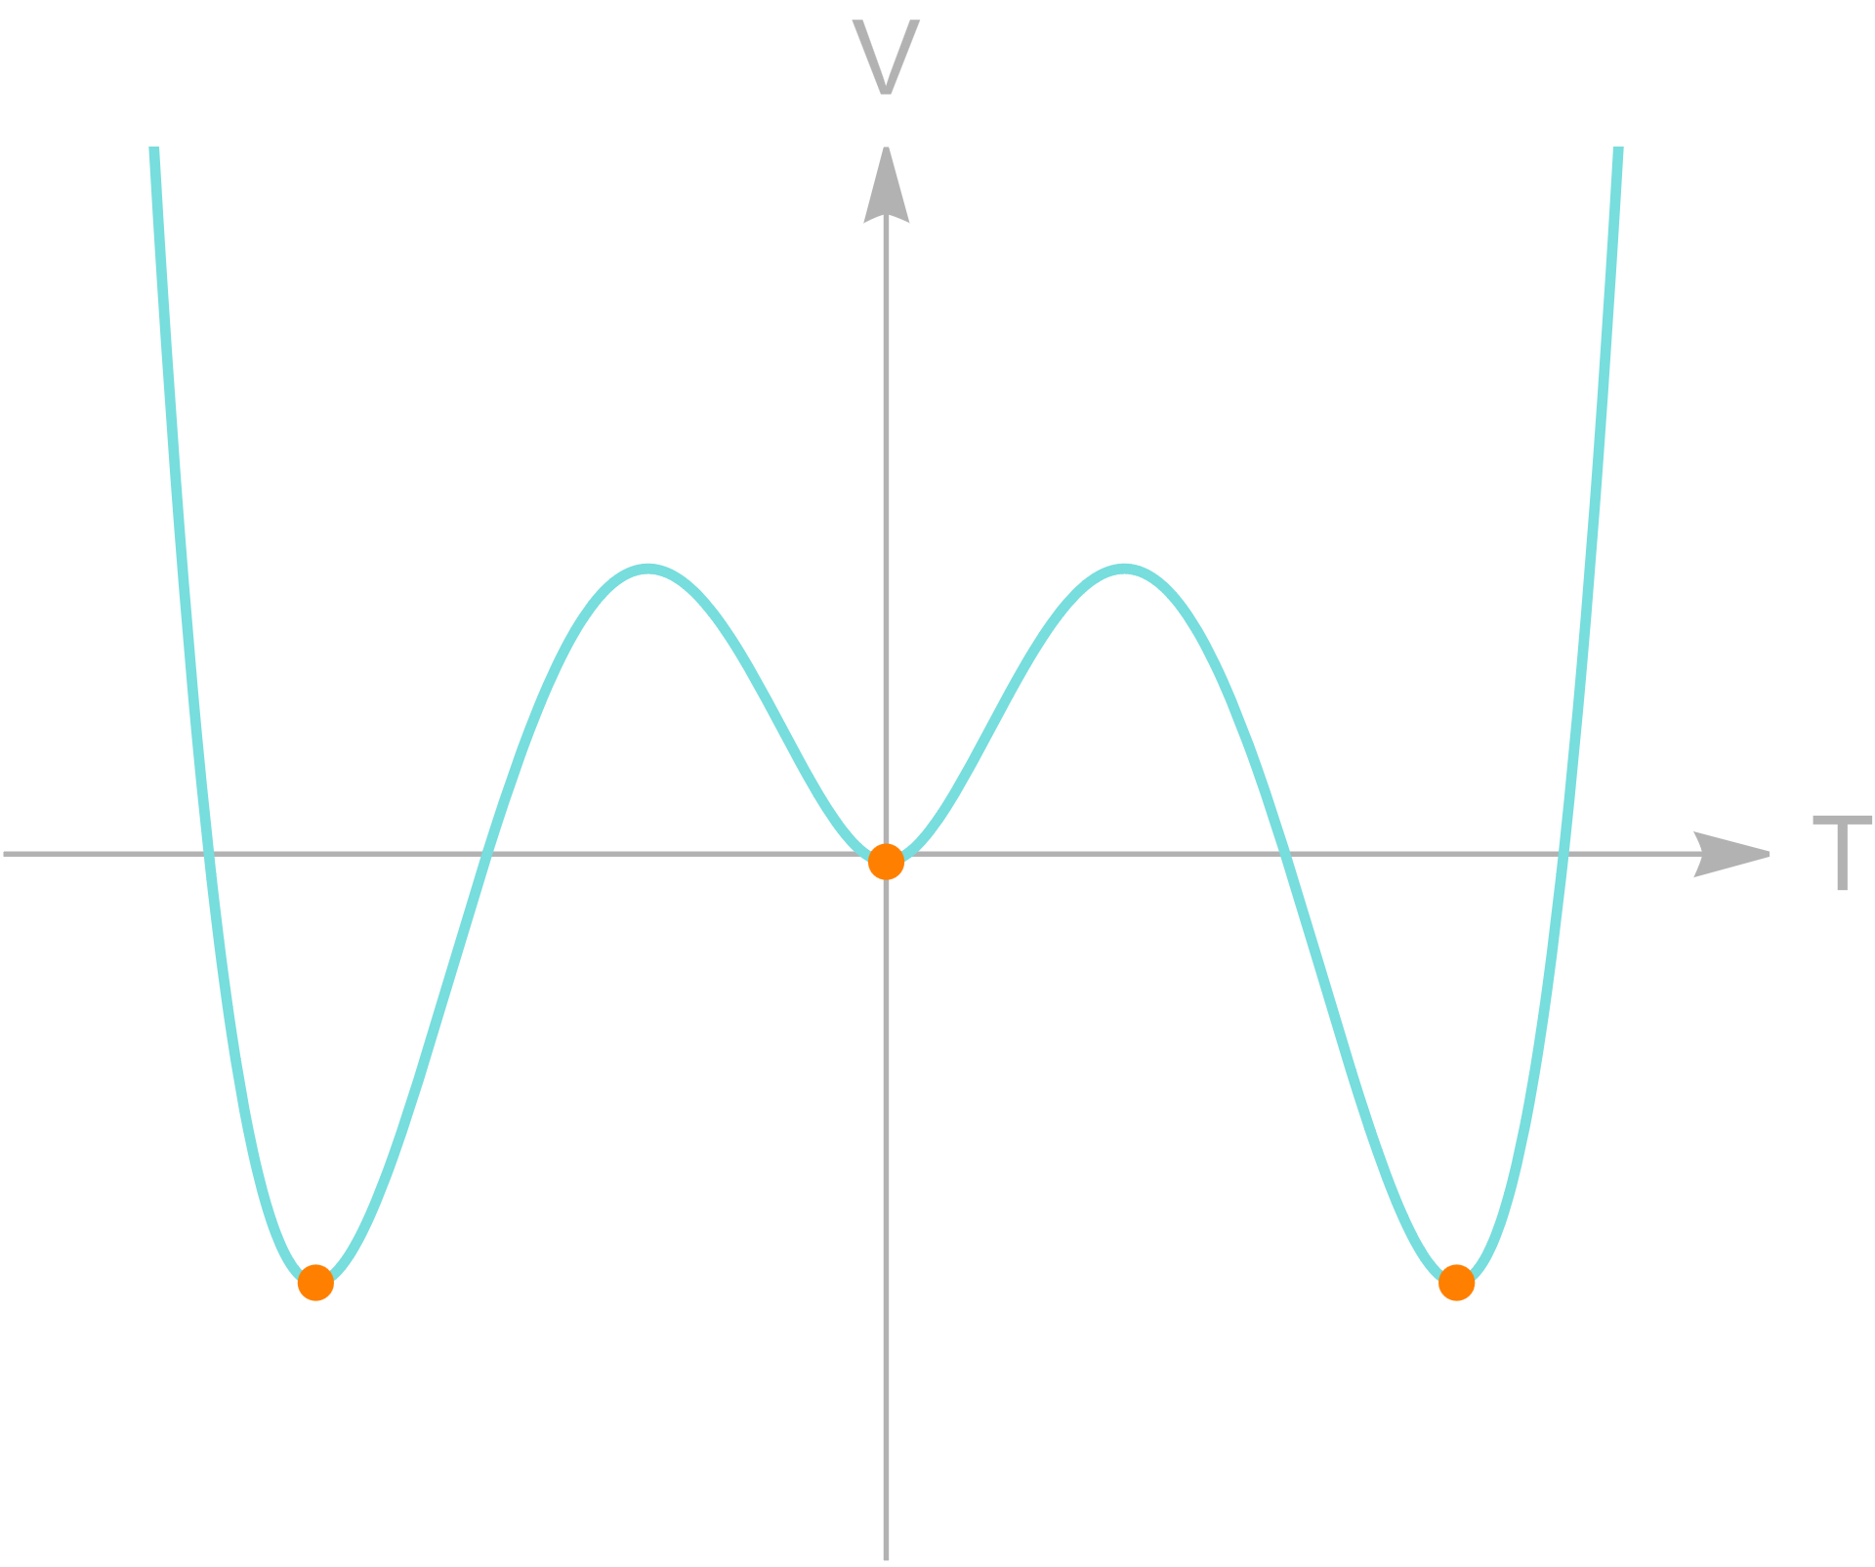
Exampl Dark photon model
Dark $U\left(1\right)$ gauge sector
Scalar content: $V\left(φ,T\right)=μ^{2}φ^{2}+λφ^{4}$
fermions
$V_{eff}$ @ NLO
Paclet
Background | Paclet | Dimensional reduction | Outlook

Slide 23
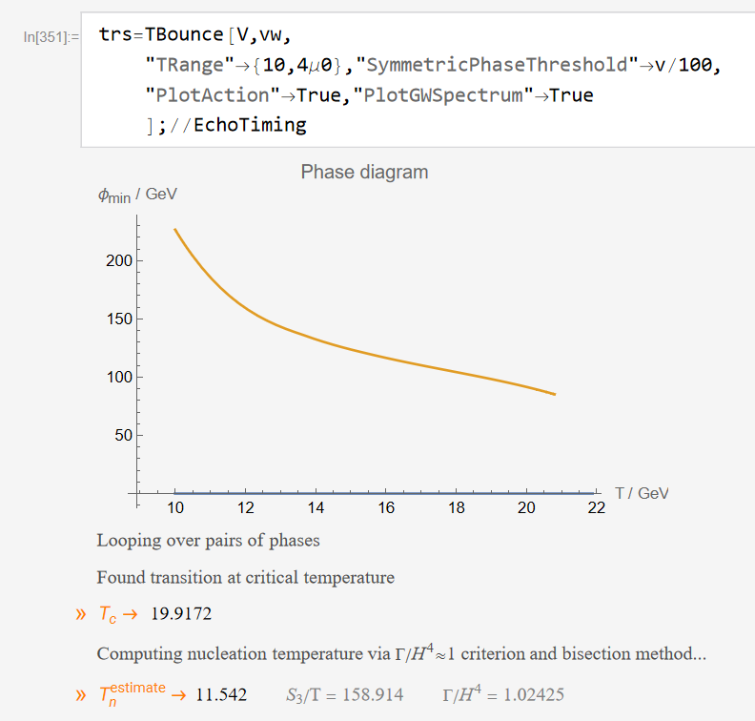
Example II Dark photon model
Dark $U\left(1\right)$ gauge sector
Scalar content: $V\left(φ,T\right)=μ^{2}φ^{2}+λφ^{4}$
fermions
$V_{eff}$ @ NLO
Paclet
Background | Paclet | Dimensional reduction | Outlook

Slide 24
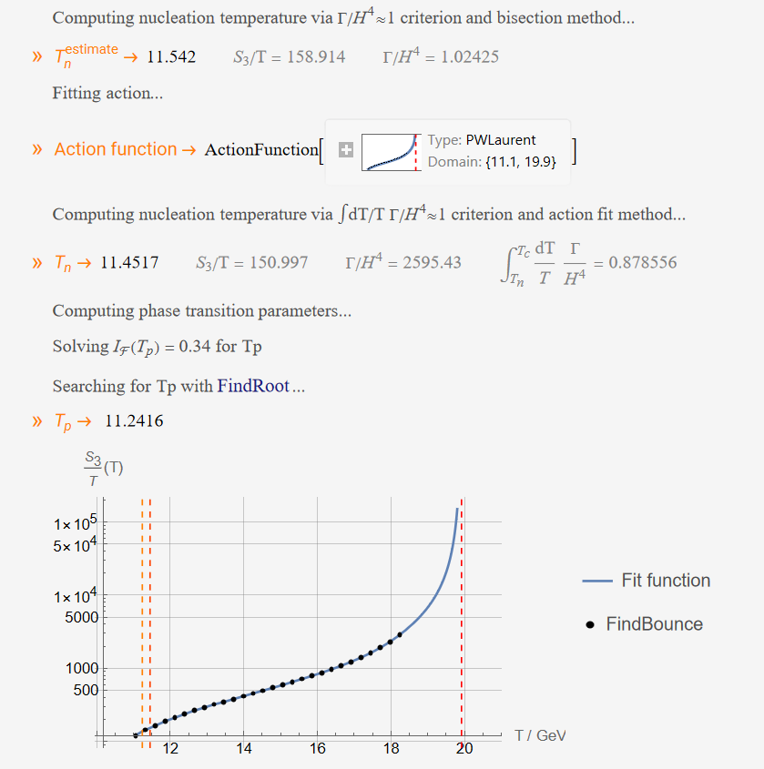
Example II Dark photon model
Dark $U\left(1\right)$ gauge sector
Scalar content: $V\left(φ,T\right)=μ^{2}φ^{2}+λφ^{4}$
fermions
$V_{eff}$ @ NLO
Paclet
Background | Paclet | Dimensional reduction | Outlook

Slide 25
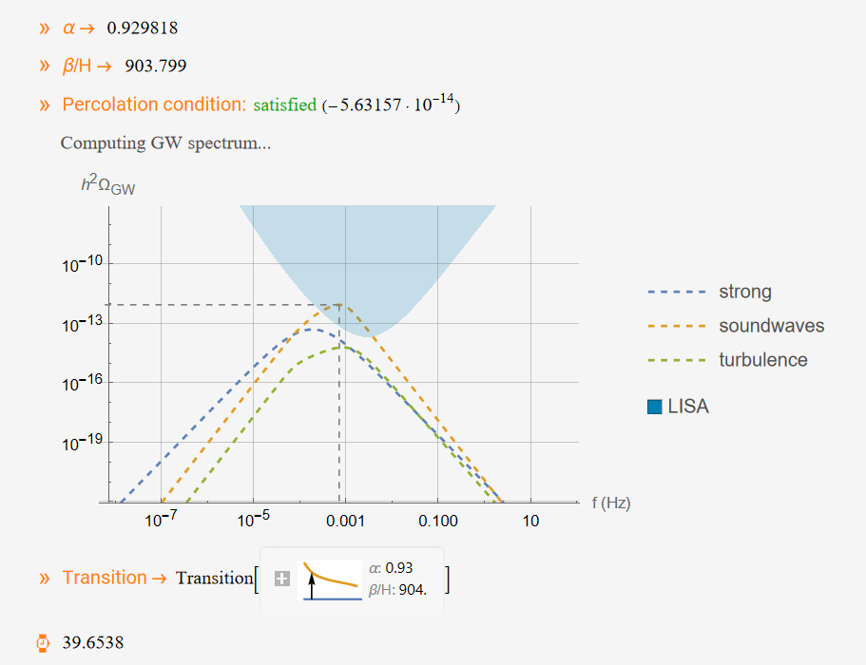
Example II Dark photon model
Dark $U\left(1\right)$ gauge sector
Scalar content: $V\left(φ,T\right)=μ^{2}φ^{2}+λφ^{4}$
fermions
$V_{eff}$ @ NLO
Paclet
Background | Paclet | Dimensional reduction | Outlook

